Slide 1

RELIVE

Slide 2
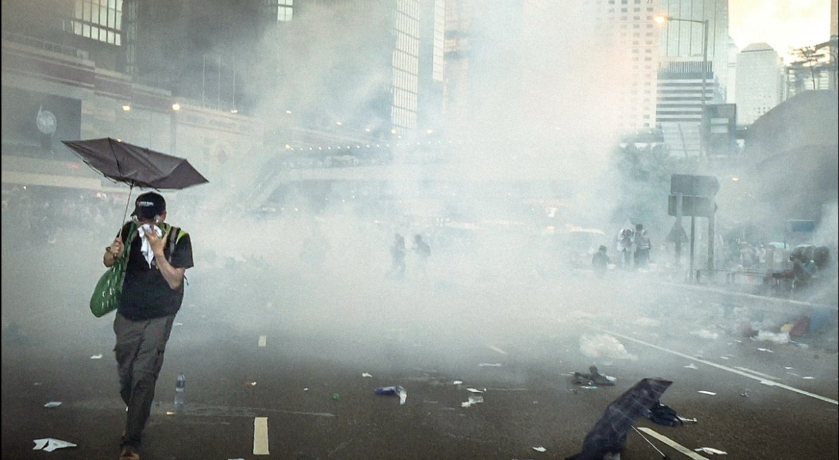
MAJOR DEMONSTRATION EARTHQUAKES AND NATURAL DISASTERS SPORT NEWS

Slide 3
Problem
Solution
Dependence on a single perspective for news.
Lack of transparency and credibility.
No interaction or control for the audience.
Difficulty engaging younger audiences.
Showcasing the event from all angles as much as it possible
Higher transparency
Questioning the authenticity of the news an immersive and interactive experience
More attractive to younger audince

Slide 4

We aim to be the leading platform in the Middle East and globally, providing an interactive experience and high credibility for viewers.
Our goal is to break the barriers between viewers and news, creating an immersive and realistic experience and becoming the eyes of the people
A comprehensive media system that integrates artificial intelligence and virtual reality to enhance the user experience.

Slide 5
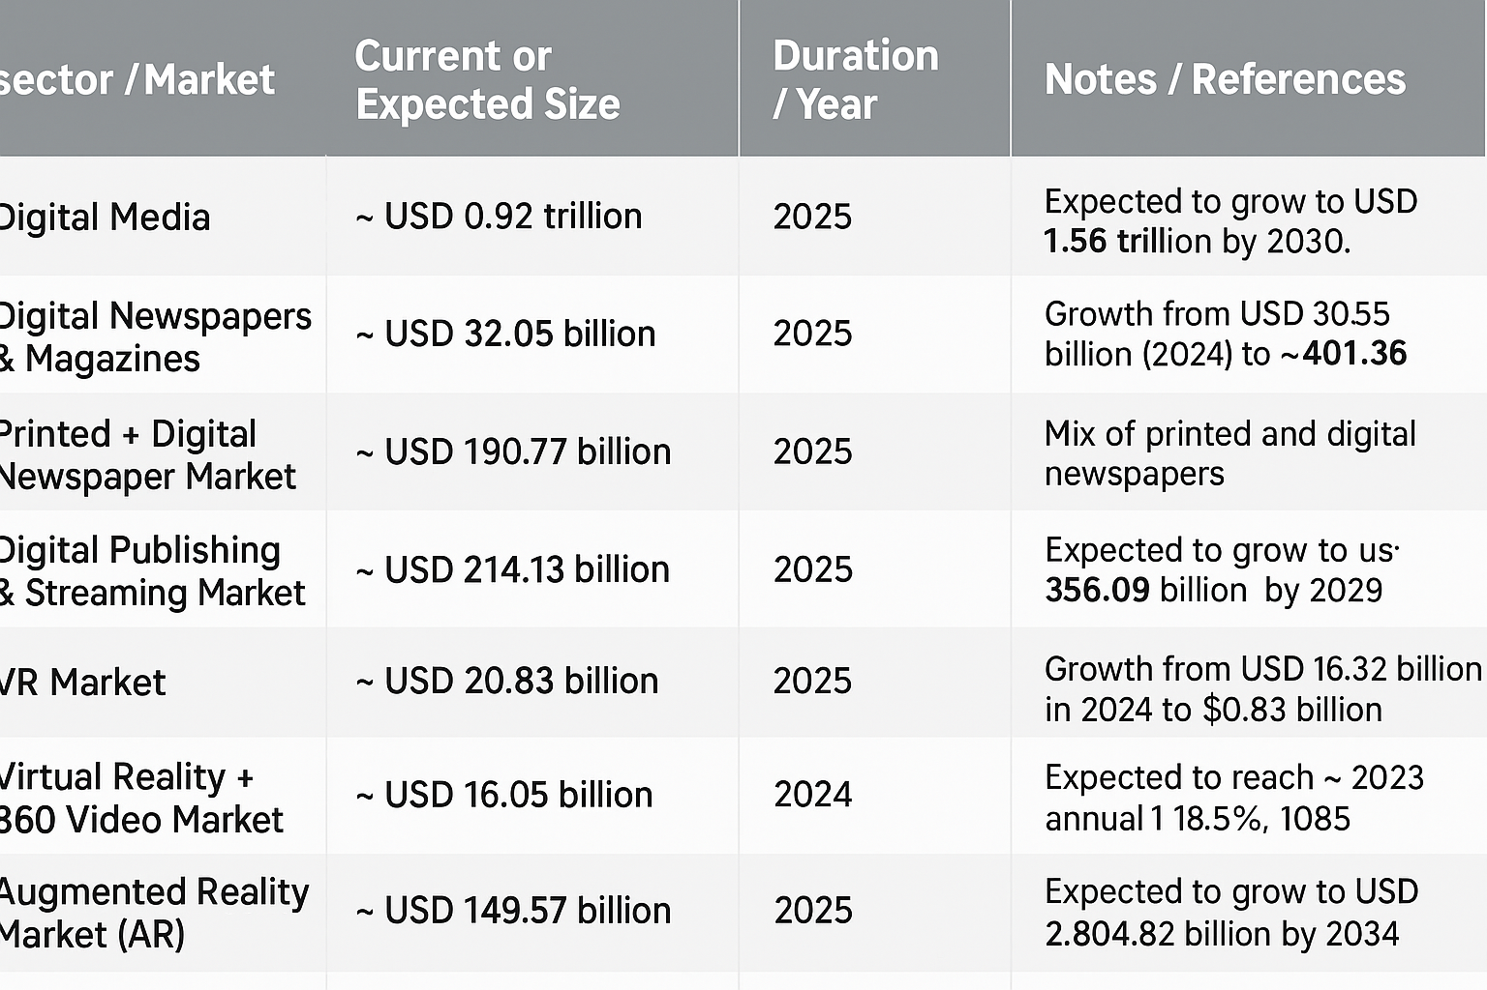
Digital media and interactive reality, exceeding $180 billion for news and $30 billion for 360° technologies globally.

Slide 6
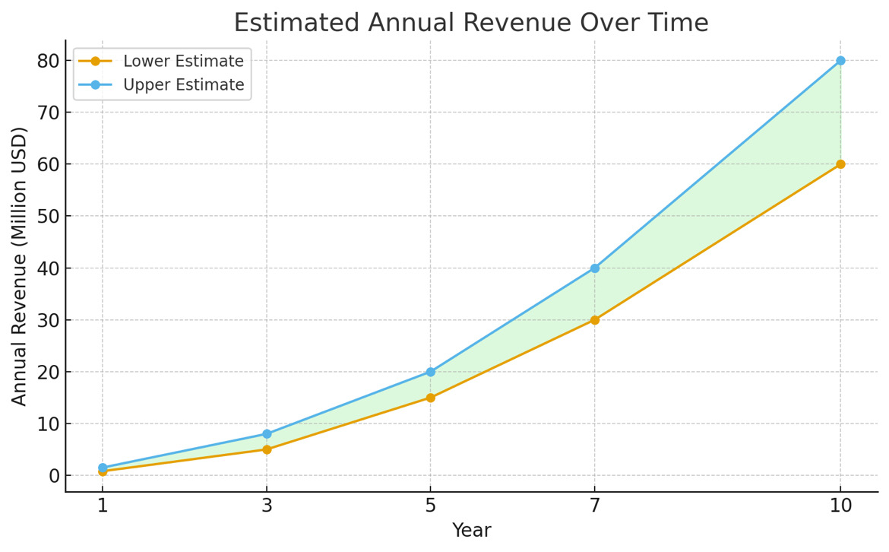
Middle East Forecast
Total Cumulative Revenue Over 10 Years: ~ $200 – $300 million if the project executes its marketing and tech plan successfully.

Slide 7
Phase 1 – Initial Launch (0–6 months)
• Build the core platform (website + live streaming and 360° video powered by AI for content analysis and processing).
• Establish a network of independent correspondents in Saudi Arabia and the UAE.
• Launch local news content with a basic credibility and rating system.
• Start initial revenue from simple digital ads.
Phase 2 – Regional Expansion (6–12 months)
• Add correspondents in other MENA countries (Egypt, Morocco, Jordan, Kuwait).
• Improve user experience (basic AI recommendations, interactive interface, subscriptions for exclusive content).
• Develop analytics and statistics for advertisers to support ad campaigns.
• Initiate media partnerships to sell exclusive content and collaborate with news channels.
Phase 3 – Advanced Digital Transformation (12–24 months)
• Launch Premium subscriptions with exclusive content and added services (ad removal, exclusive 360° clips).
• Expand infrastructure to support global live streaming of major events.
• Increase revenue from media partnerships and B2B services.
Phase 4 – Innovation and Differentiation (24–36 months)
• Introduce VR/AR News Experience using virtual or augmented reality headsets.
• Add live interaction features (polls, live comments, user-driven news ratings).
• Launch services for educational and media institutions (journalist training, live event broadcasting for universities or channels).
• Target advanced and interactive advertising markets within VR and 360° videos.
Phase 5 – Global Expansion (36–60 months)
• Enter global markets with independent correspondents and international media partnerships.
• Develop the AI system to provide precise personalized recommendations for each user.
• Build an integrated interactive journalism platform (video, VR, articles, and live analytics).
• Achieve an ambitious market share of 0.5–1% of the regional SAM.

Slide 8
Target audience
Young digital users (18–35 years old)
Those interested in local and regional news
The tech-savvy audience and lovers of new experiences
Institutions and advertising companies
Universities and media academies
Satellite channels, websites, and production companies wishing to purchase exclusive content or cooperate on coverages

Slide 9
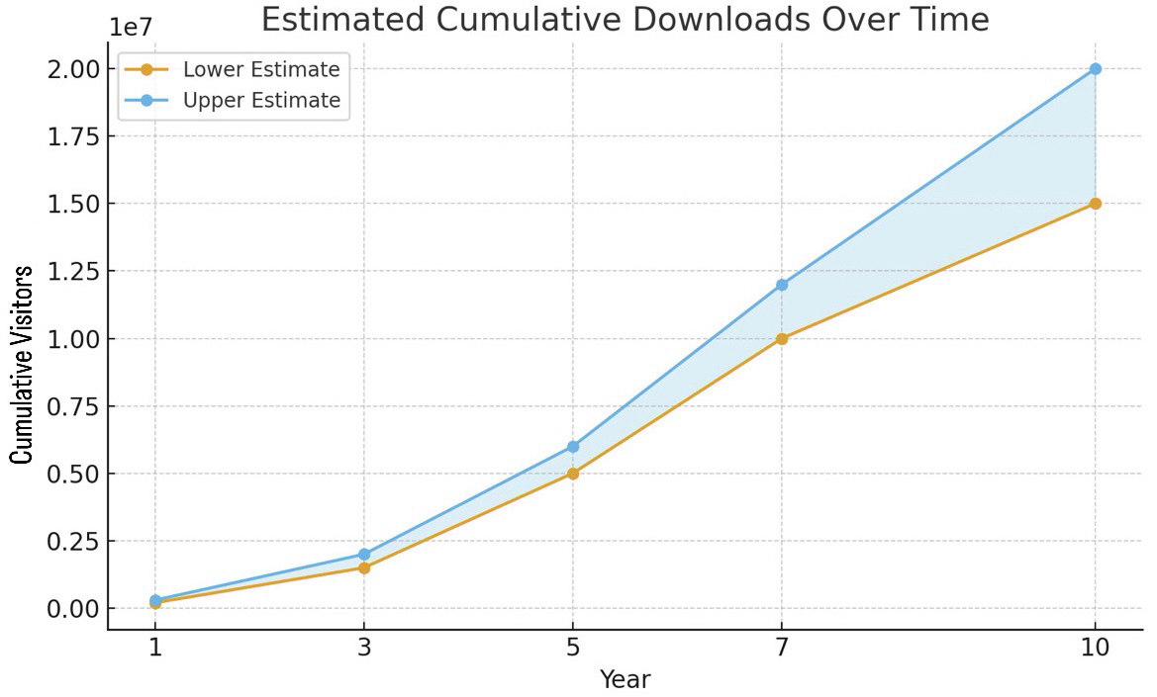

Slide 10
We will use artificial intelligence for video processing and retouching in 360 technology, in addition to news analysis, content classification, sentiment analysis, case study, event evaluation, and future predictions, as well as performing Obfuscation (hiding/obscuring) or Masking (data masking) to preserve privacy. # This is the artificial intelligence plan on the website
Google Gemini Function on our website:
News Summarization
News Categorization
Sentiment Analysis
We used Firebase in the website to provide a ready-made SDK for the frontend (JS).
Dialogflow / Google Studio on the web:
The Dialogflow SDK works directly with JS.
Google Studio provides embed iframe codes to display reports inside the website.

Slide 11
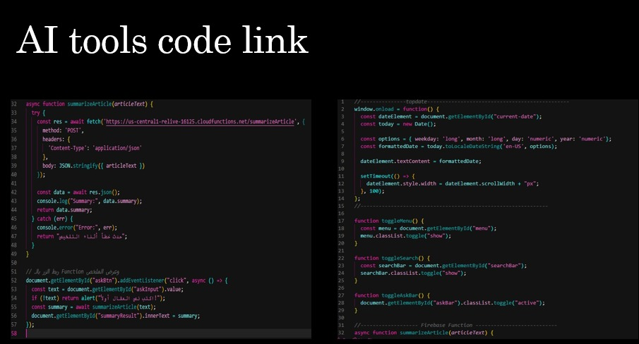

Slide 12
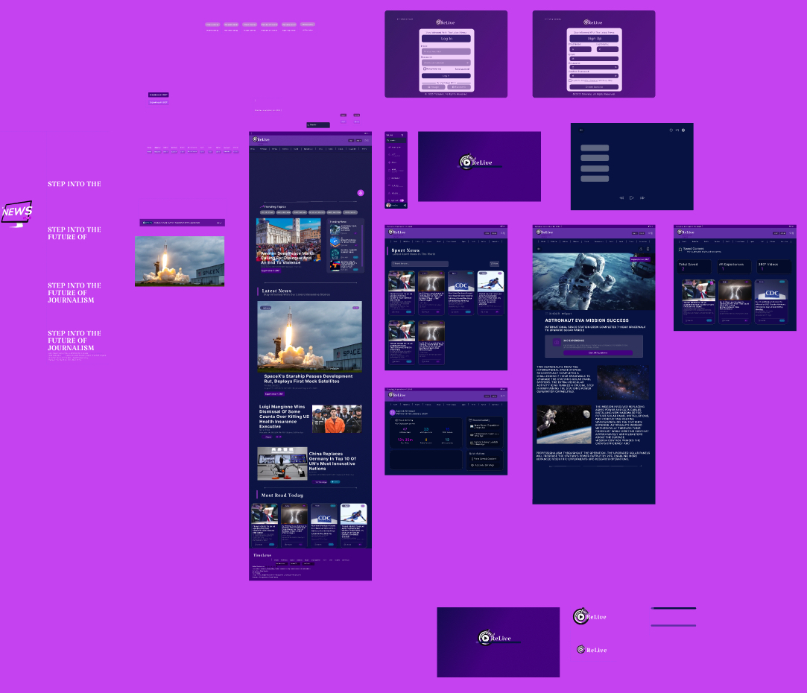
Our figma ; visualize the website in its initial conceptأ

Slide 13
Core Management
• CEO / Founder
• COO / Operations Manager
• CFO / Financial Manager⸻
Tech Team
• CTO / Technology Director
• Software Engineers (Web & Mobile)
• Live Streaming / 360 Video Engineers
• AI Engineer / Data Scientist
• VR/AR Engineer
Content Team
• Content Manager
• Independent / Local Reporters
• Video Editor
• Fact-checker
Marketing & Sales
• Digital Marketing Manager
• Digital Advertising Specialists
• Public Relations & Media Partnerships
Operations & Support
• Tech Support
• Community Manager
The required team

